Slide 1
Architecture management in MATLAB
Testing and validation plaforms
Master Degree in Smart Energy Systems

Slide 2
Contents
Creating architectures
Stereotypes
Link to requirements
Views
Interfaces
Other features

Slide 3
Contents
System Architecture with MATLAB & Simulink
System composer
https://es.mathworks.com/products/system-composer.html
System composer examples
https://es.mathworks.com/help/systemcomposer/examples.html
Best way to learn!

Slide 4
Contents
This tutorial is based on this example:
https://www.mathworks.com/help/systemcomposer/ug/mobile-robot-workflow.html
(open it writing openExample('systemcomposer/SimulatingMobileRobotWithSystemComposerWorkflowExample’) in command window)

Slide 5
Creating architectures
1

Slide 6
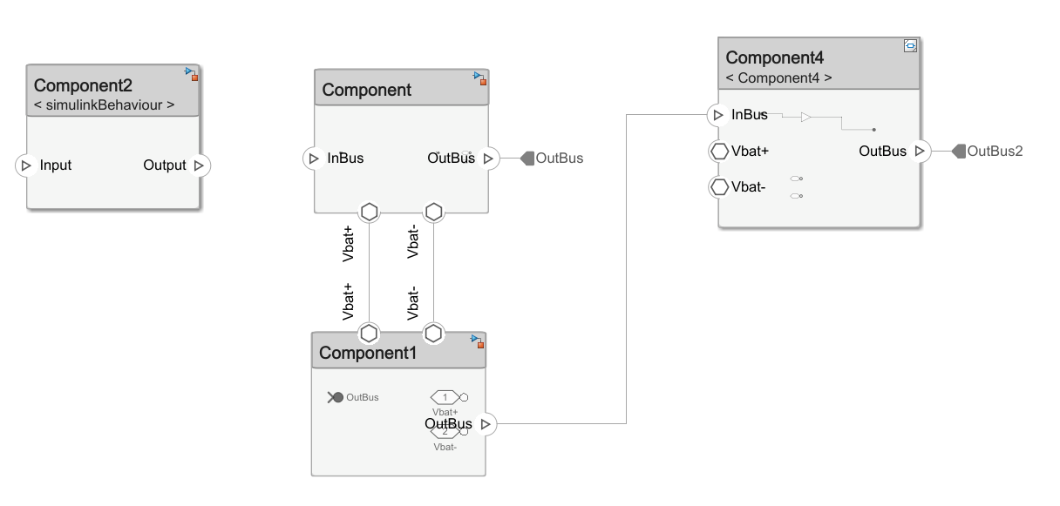
Fundamental components
The fundamental block of an architecture is the component.
Ports
Signals
Component
Physical ports (for Simscape)

Slide 7
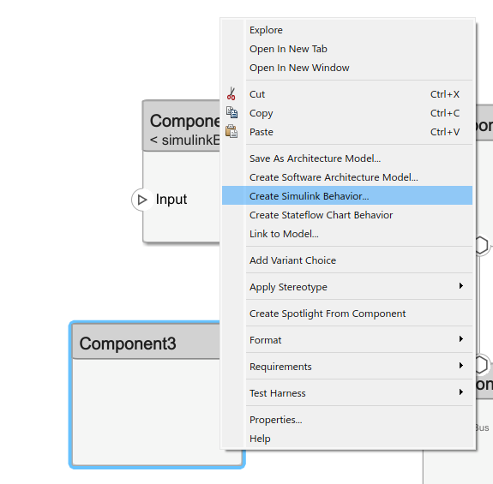
Fundamental components
A component can be linked to other files:
Architecture model: nested architectures.
Software Architecture Model: nested software architecture model.
Simulink Behavior: Classic Simulink file.
Stateflow Chart Behaviour: behavior in stateflow.
Link to model: link to an existing model

Slide 8
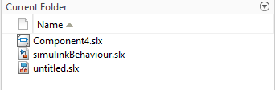
Fundamental components
A component can be linked to a behaviour (simulation/stateflow chart).
Subsystem component: behaviour embedded in System Composer.
Referenced subsystem: behaviour in separate subsystem file.
Referenced component: behaviour in separate Simulink file.
Can’t be used with physical ports.
Architecture file

Slide 9


Fundamental components
A component can be linked to a behaviour (simulation/stateflow chart).
Subsystem component: behaviour embedded in System Composer.
Referenced subsystem: behaviour in separate subsystem file.
Referenced component: behaviour in separate Simulink file. Can’t be used with physical ports.
Architecture and behaviour only in one file
Subsystem in separate file. Can be reused.
Whole model in separate file. Can be tested separately.
Subsystems can’t be tested separately
Subsystem file can’t be simulated outside architecture
Can’t use physical interfaces

Slide 10
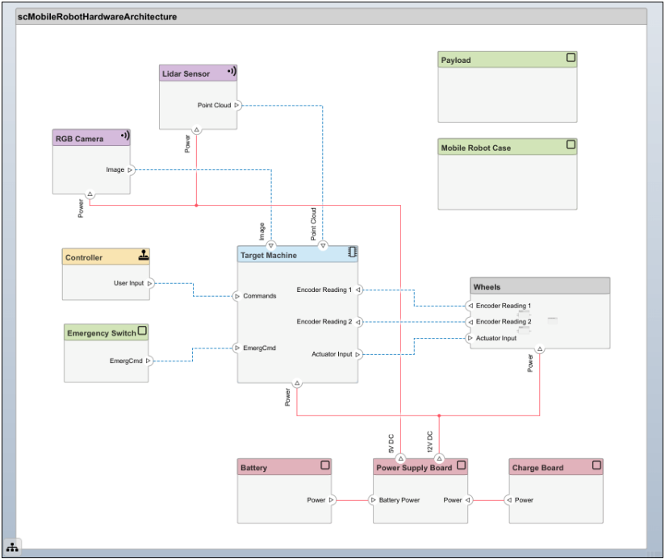
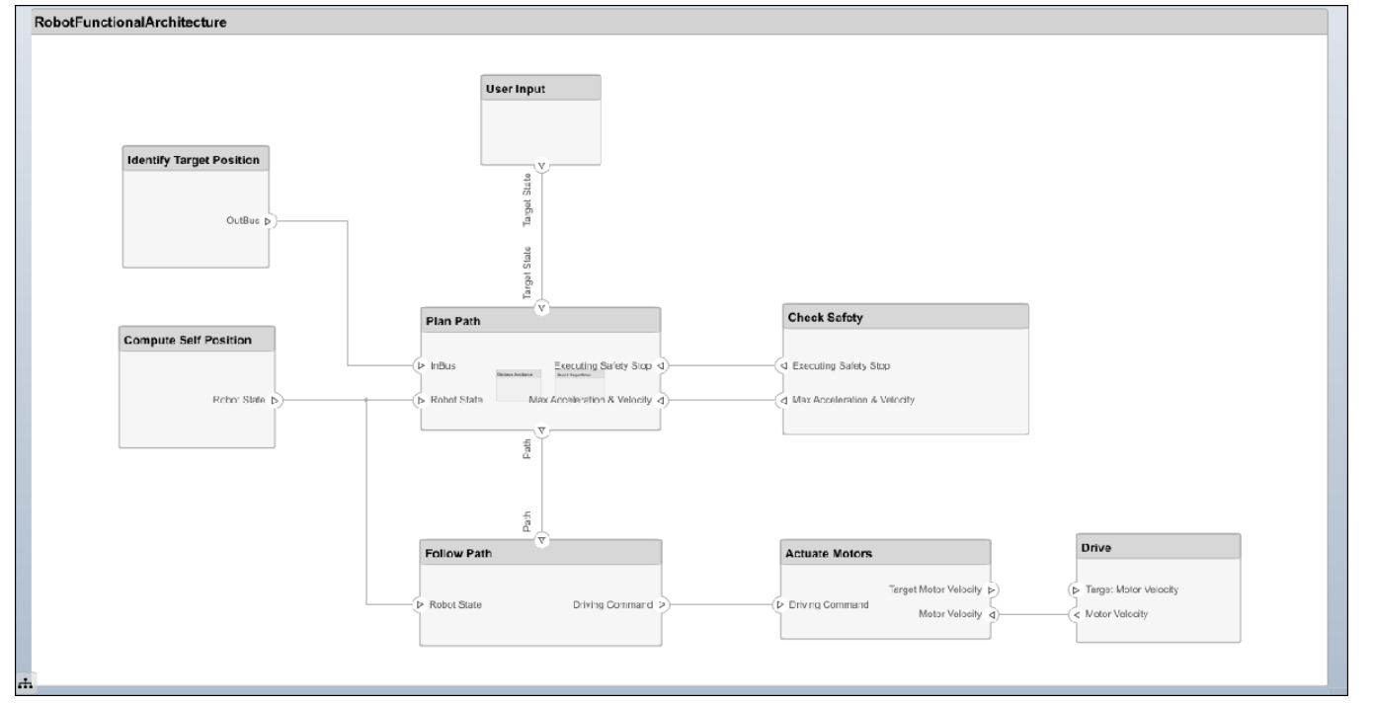
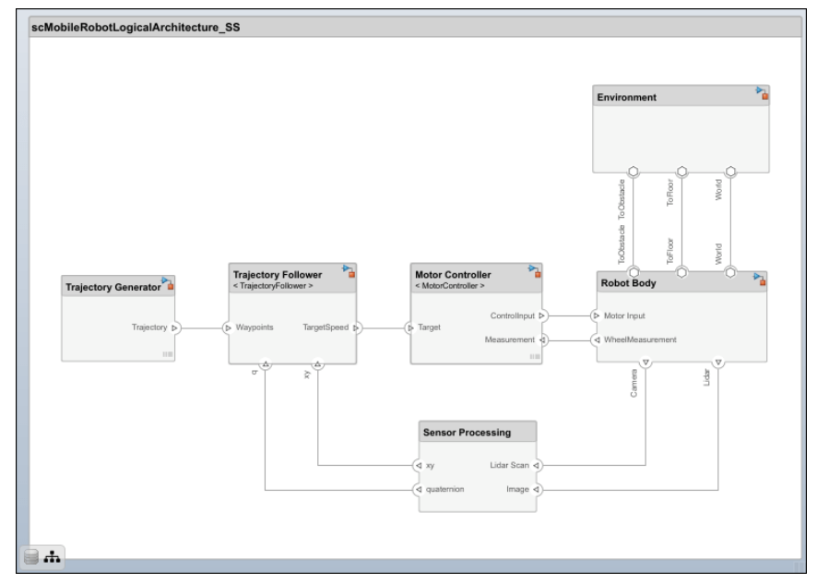
Architecture models
An architecture is a decomposition of the system.
There is not a single decomposition!
Example:
Functional architecture describes high-level functions and the relationships between them.
Logical architecture describes data exchange between electronic hardware and software components in each subsystem.
Physical architecture describes the physical hardware or platform needed for the robot.
scMobileRobotHardwareArchitecture.slx
\scMobileRobotExample\Architectures\
RobotFunctionalArchitecture.slx
Functional
Logical
Physical
scMobileRobotLogicalArchitecture.slx

Slide 11
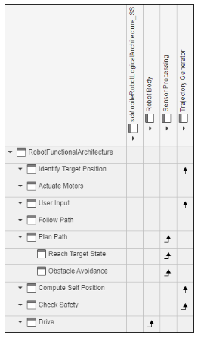
Allocate architectures
You can allocate components from different architectures using model-to-model allocations
Use the Allocation Editor for this issue
Extremely interesting to know if a physical component has any interaction with a function for Example.
Functional to logical allocation

Slide 12
Stereotypes
2

Slide 13
Stereotypes
When an architecture is defined in System Composer, you may need to add additional information to components.
You can see here a physical (hardware) architecture example.
We may need to classify components or signals to make the architecture more readable.

Slide 14
Stereotypes
Stereotypes help managing additional information.
Component/signal types can be customized with stereotypes.
Without stereotypes
With stereotypes
scMobileRobotHardwareArchitecture.slx

Slide 15

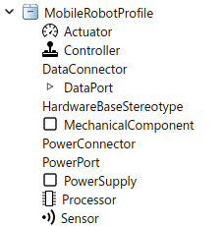
Stereotypes
Open profile editor in Simulink
The steps to work with stereotypes are:
Create a profile: a group of stereotype definitions. We choose which kind of signals and components we have. We define their properties and styles.
Import a profile: We can use the same profile in different architectures, so we need to import one to ours.
Assign stereotypes: Assign a stereotype to each component/signal.

Slide 16
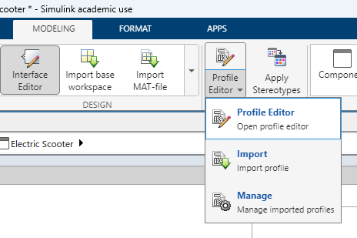
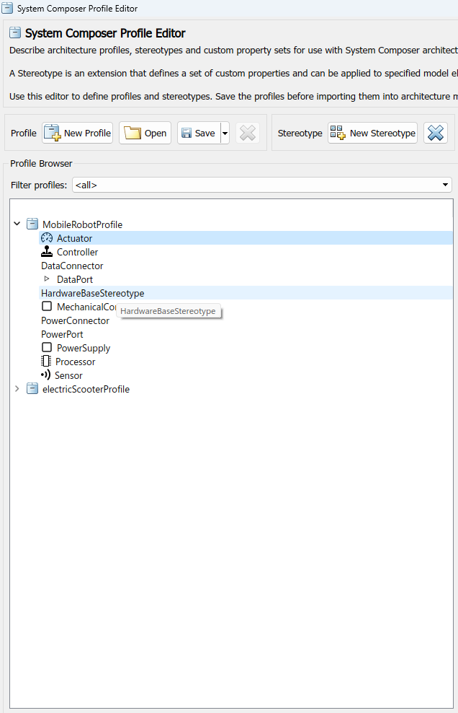
Stereotypes
Stereotype profiles are created and managed with the profile editor.
A profile is saved separately in a .xml file.
Inside a profile we can have several stereotypes.
This example is a hardware architecture, so defines different hardware components: actuators, controllers, processors, sensors,… As well as connectors: power, data,…

Slide 17
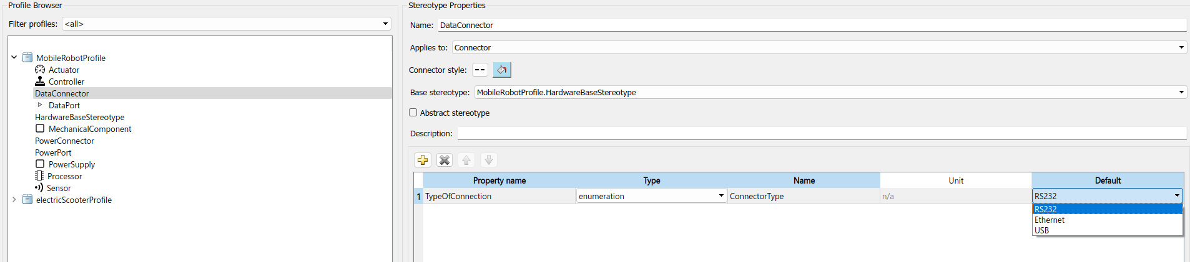
Stereotypes – create profile
The information linked to a stereotype is specified using properties.
For example, the DataConnector stereotype has a field to specify the connector type.

Slide 18
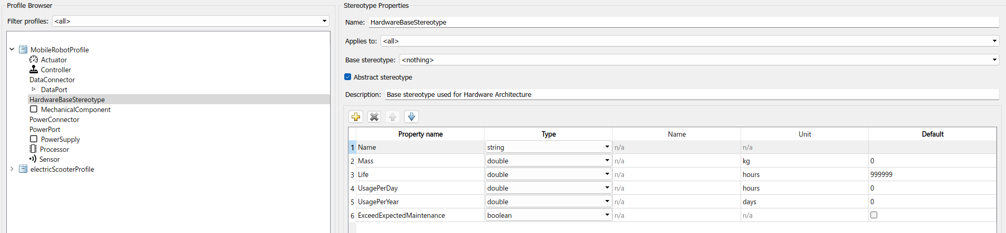
Stereotypes – create profile
A Base stereotype can also be used.
Instead of defining properties in all stereotypes one by one, we can create a base that all will share.
DataConnector has its properties + all the ones defined in the base stereotype

Slide 19
Stereotypes – import profile
After creating a profile, it must be imported to the architecture.
When a profile is created, it is saved as a .xml file. That file must be imported using the import button.
Once imported, stereotypes will be available.

Slide 20
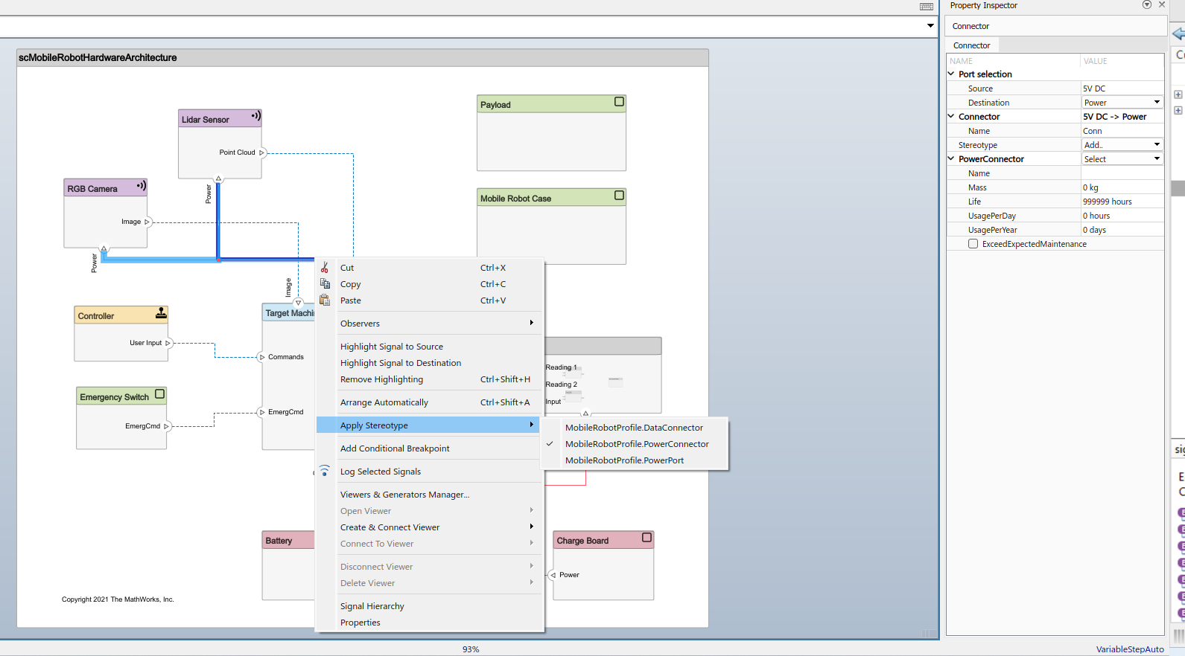
Stereotypes – assign stereotypes
Stereotypes are assigned right-clicking the component/signal.
The properties linked to the stereotype are shown in the property inspector.

Slide 21
Stereotypes – assign stereotypes
The final result is an architecture with stereotypes defined.

Slide 22
Link to requirements
3

Slide 23
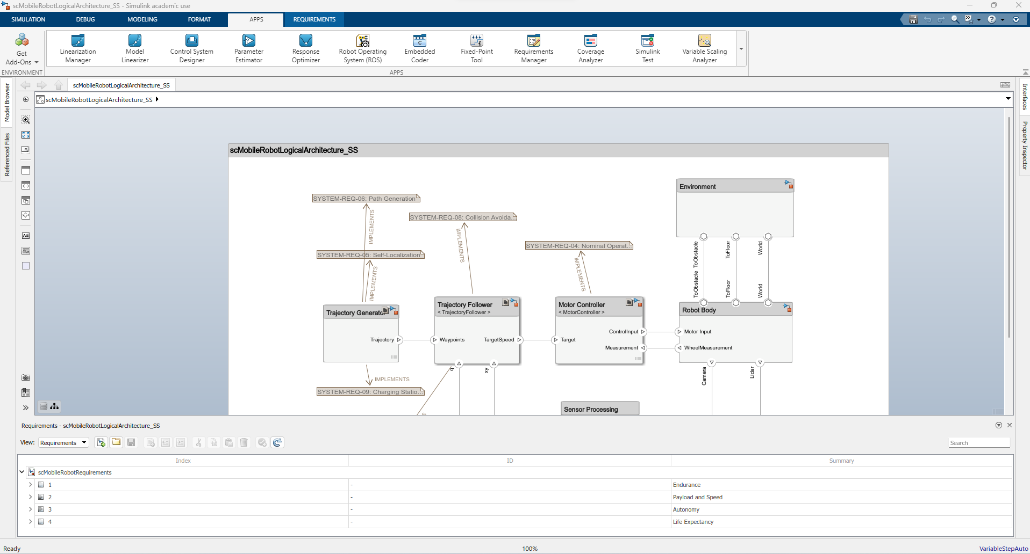
Requirements in system composer
Once we have our architecture defined, we can link each component to requirements (drag and drop).
Requirements are available in Simulink.

Slide 24
Requirements in system composer
Previously created requirements can be loaded to Simulink.
Requirements can directly be created in Simulink also.

Slide 25
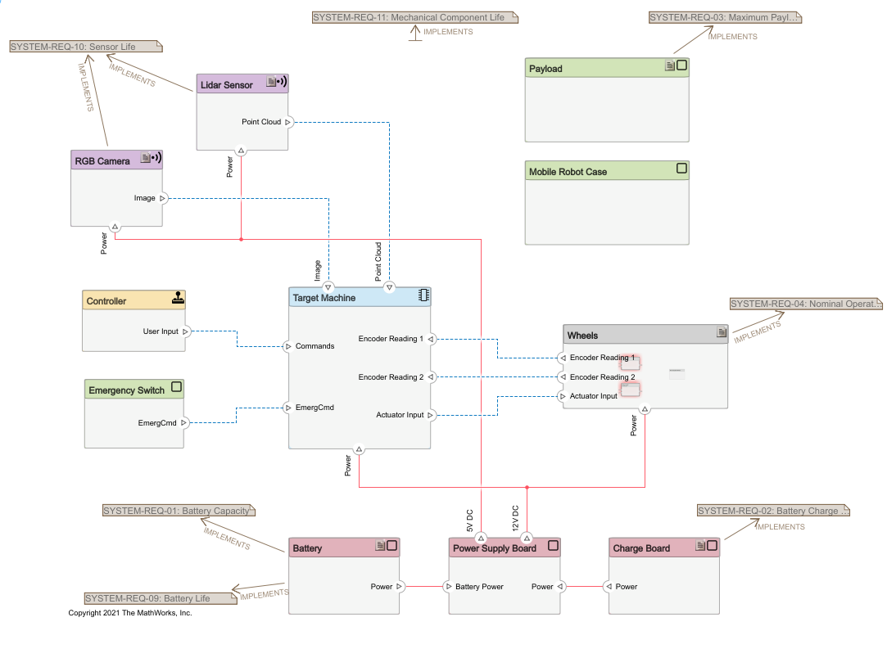
Requirements in system composer
Requirements can be linked to a particular component or the whole architecture.

Slide 26
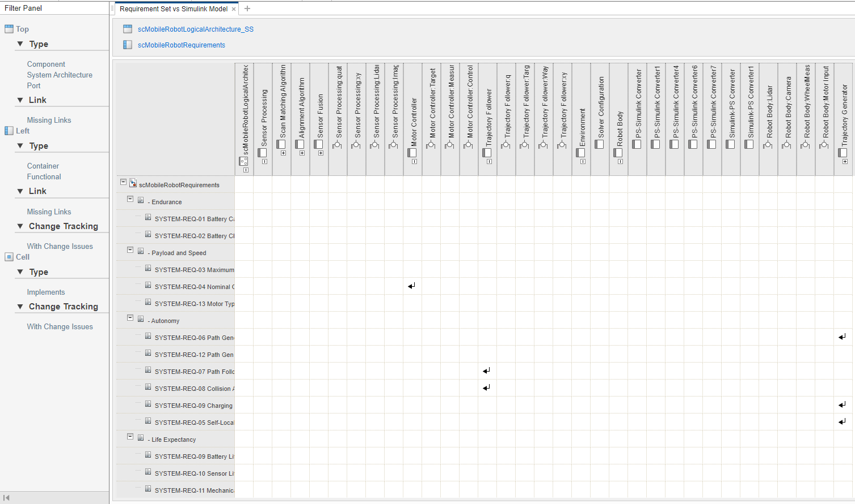
Requirements in system composer
The traceability matrix shows the link to different artifacts (other requirements, architectures,…).
architecture
requirements

Slide 27
Views
4

Slide 28
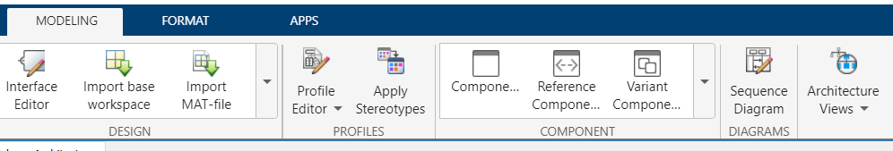
Architecture views
Modeling\architecture views
Different views of an architecture allow:
Viewing a system based on different hierarchies.
Create filtered views.

Slide 29
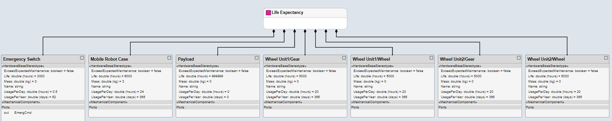
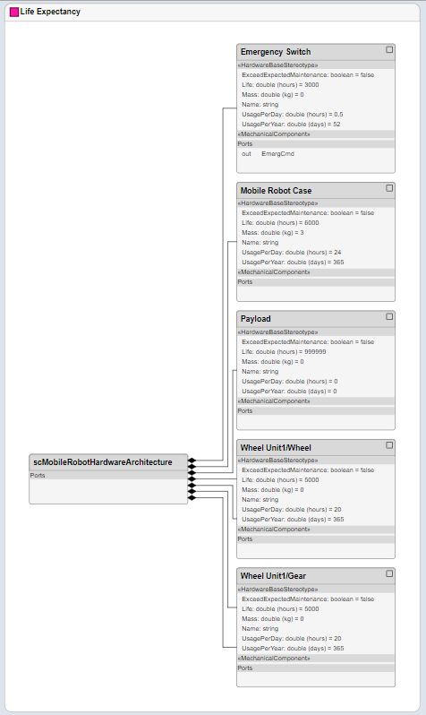
Architecture views
Different views of the architecture
Component hierarchy
Architecture hierarchy

Slide 30
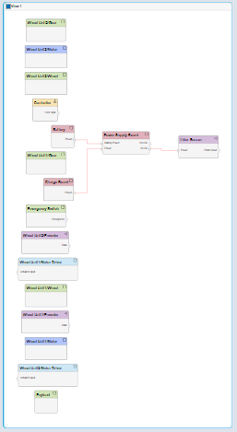
Architecture views
Different views of the architecture
Component diagram
Component diagram of components below 1 kg mass

Slide 31
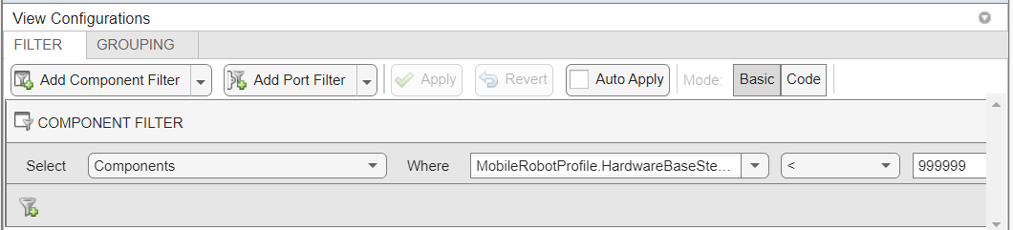
Architecture views - filters
Filtered views
Filter components respect to a defined stereotype property.
For Example:
View of components with life expectancy issues
Check which components have low life expectancy.

Slide 32
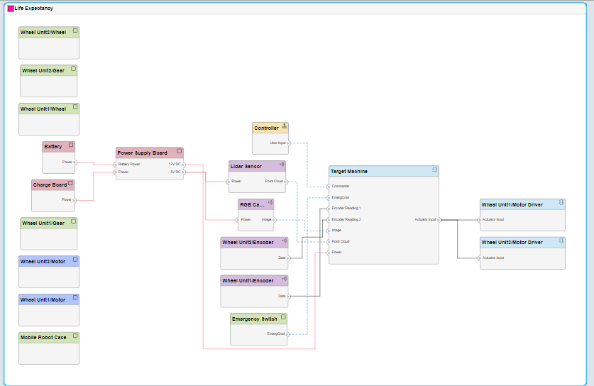
Architecture views
Filtered views
Component diagram of the life expectancy filter.
Very interesting to check the impact of the component in a desired characteristic
View of life expectancy dependant components

Slide 33
Interfaces
5

Slide 34
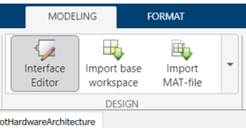
Interface editor
Option in Simulink to define interfaces (interconnections) between different components
Modeling/ Interface editor
Not defining correctly interfaces generates big problems in complex systems/projects

Slide 35
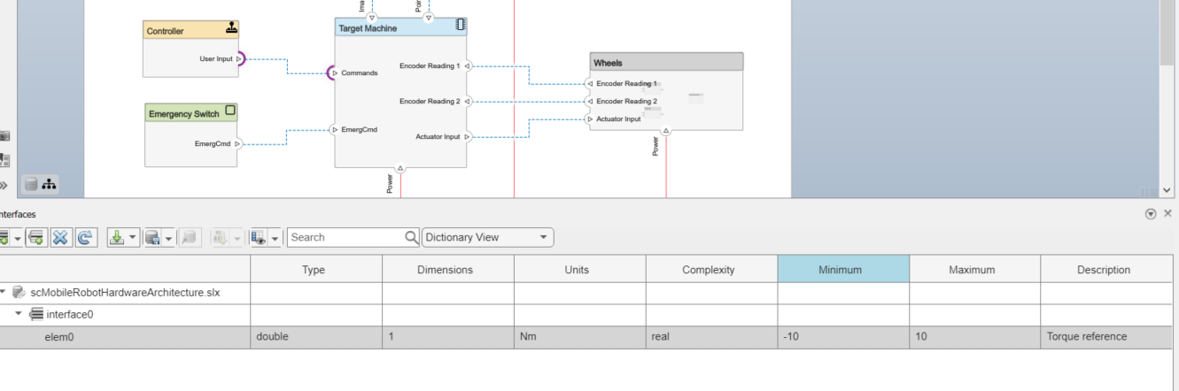
Interface editor
Example:
Modeling/ Interface editor
Both ports are part of the same interface.

Slide 36
Other features System Composer
6

Slide 37
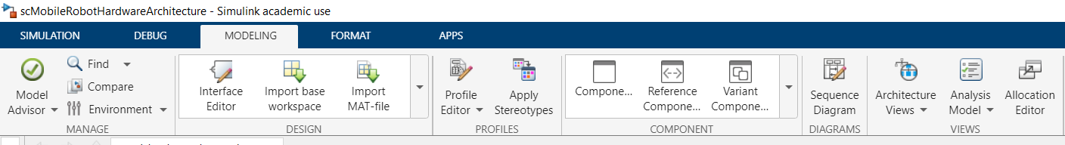
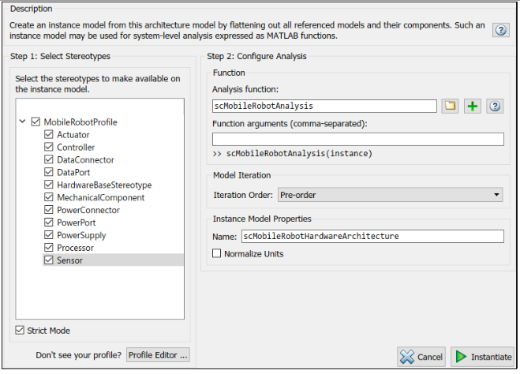
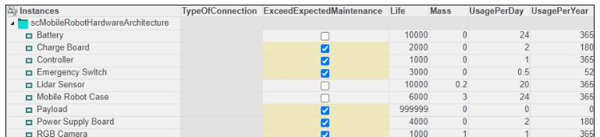
Analysis model
Life time expectancy of components in a system.
Reports
Instantiate architecture model

Slide 38
Eskerrik asko
Muchas gracias
Thank you
Jon del Olmo Larrañaga
jdelolmo@mondragon.edu
Iosu Aizpuru
iaizpuru@mondragon.edu
Orona Ideo - Fundazioa eraikuntza
Jauregi Bailara, z.g.
20120 Hernani (Gipuzkoa)
Tel. : +(34) 943 739765
www.mondragon.edu

